Slide 1

* Mục đích: Provide students:
+ Grammar: Uses of infinitive (with to);
+ Vocabulary: verbs + infinitive
+ Pronunciation and speaking : word stress
* Yêu cầu: After lesson, students can:
+ Uses of infinitive (with to) correctly to make sentences
+ Read and pronoun correctly word stress

Slide 2
1. Speaking
Answer the following questions:
Do you like going to the parties? Why/ why not?
Do you like giving parties? Why/ Why not?
When was the last time you went to a party or celebration? (eg: a wedding, a birthday party, etc)
Whose party was it?
Did you have a good time?
Did you meet anybody new?
What ddid you have to eat and drink?
Did you stay until the end?

Slide 3
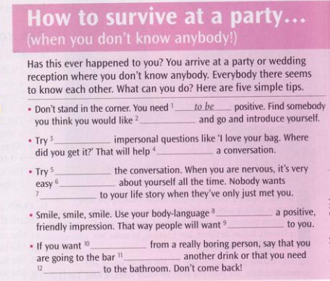
2. Grammar: uses of the infinitive (with to)
a) Read the article about parties. Complete the five rules with an infinitive.
to ask to be not to dominate
to escape to get to give
to go to listen to meet
to start to talk (x2)
to meet
to ask
to start
not to dominate
to talk
to listen
to give
to talk
to escape
to get
to go

Slide 4
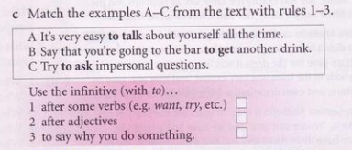
C
A
B

Slide 5
Uses of the infinitive (with to):
After some verbs: (want, need, would like, etc.)
Ex: I want to go to the party
He needs to buy some new clothes
After adjectives: (easy, difficult, important, etc.)
Ex: It isn’t easy to find a job.
It’ll be nice to meet some new people

Slide 6
To say why you do something.
Ex: A. Why did you go to the party?
B. To meet new people.
(= I went to the party to meet new people)
I came to this school to learn Enghlish. NOT for learn Enghlish
After a question word (what, where, when, how, etc.)
Ex: Do you know how to use this computer?
I don’t know where to go.

Slide 7
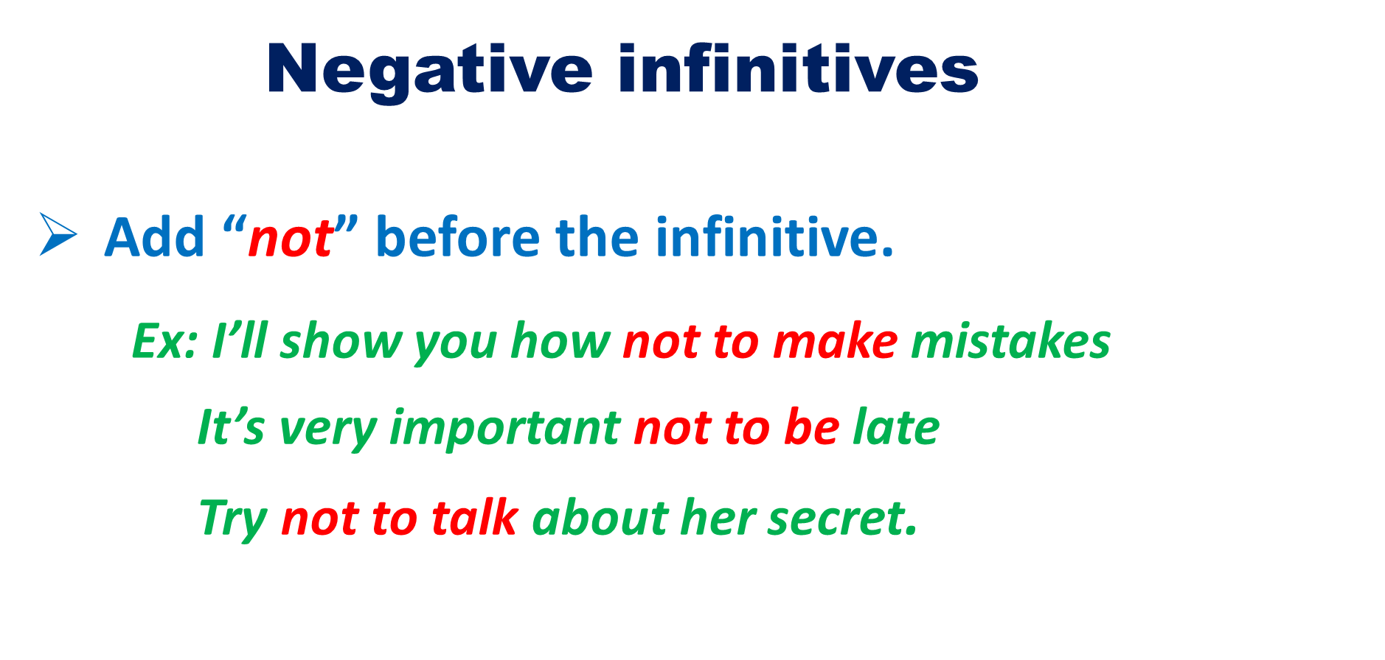

Slide 8
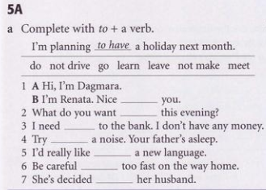
Exercises
to meet
to do
to go
not to make
to learn
not to drive
to leave

Slide 9
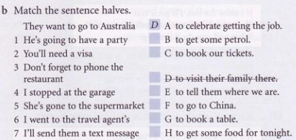
A
F
G
B
H
C
E
https://quizizz.com

Slide 10
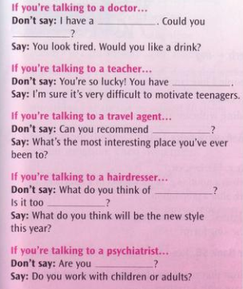

problem with my back
have a
look at it
a really long summer holidays
a cheap holidays?
my colour
blond
analying me

Slide 11

Listen to the people at the party again. Complete the conversations with an infinitive.
Conversation 1: I want _____ ______ him a “Happy birthday”.
Conversation 2: Perhaps you would like _____ _____ my class one day
Conversation 3: I’d like _____ _____ somewhere _____ .
Conversation 4: You’re just the person I want _____ _____ to.
Conversation 5: I need _____ _____ to the ___________
to
wish
to
teach
to
go
hot
to
talk
to
go
bathroom

Slide 12
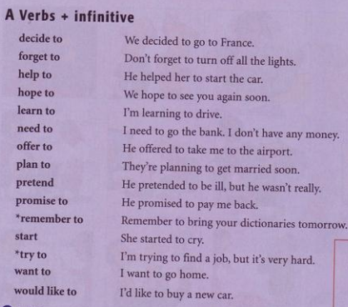

Slide 13
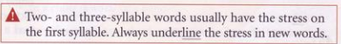
Dangerous
Decide
Difficult
Forget
Important
/’deindʒrəs/
/di’said/
/’diffikəlt/
/fə’get/
/im’pɔːtənt/
Interesting
Possible
Pretend
Promise
Remember
/’intristiŋ/
/’pɔsəbl/
/pri’tend/
/’prɔmis/
/ri’membə/

Slide 14
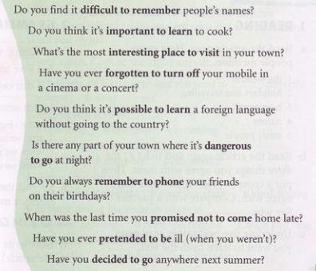

Slide 15
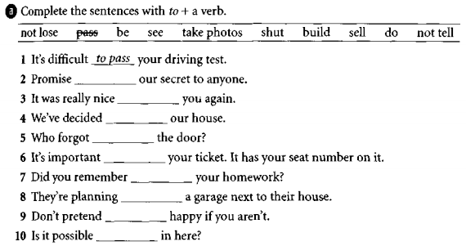
Exercises
not to tell
to see
to sell
to shut
not to lose
to do
to build
to be
to take photos

Slide 16
